Slide 1
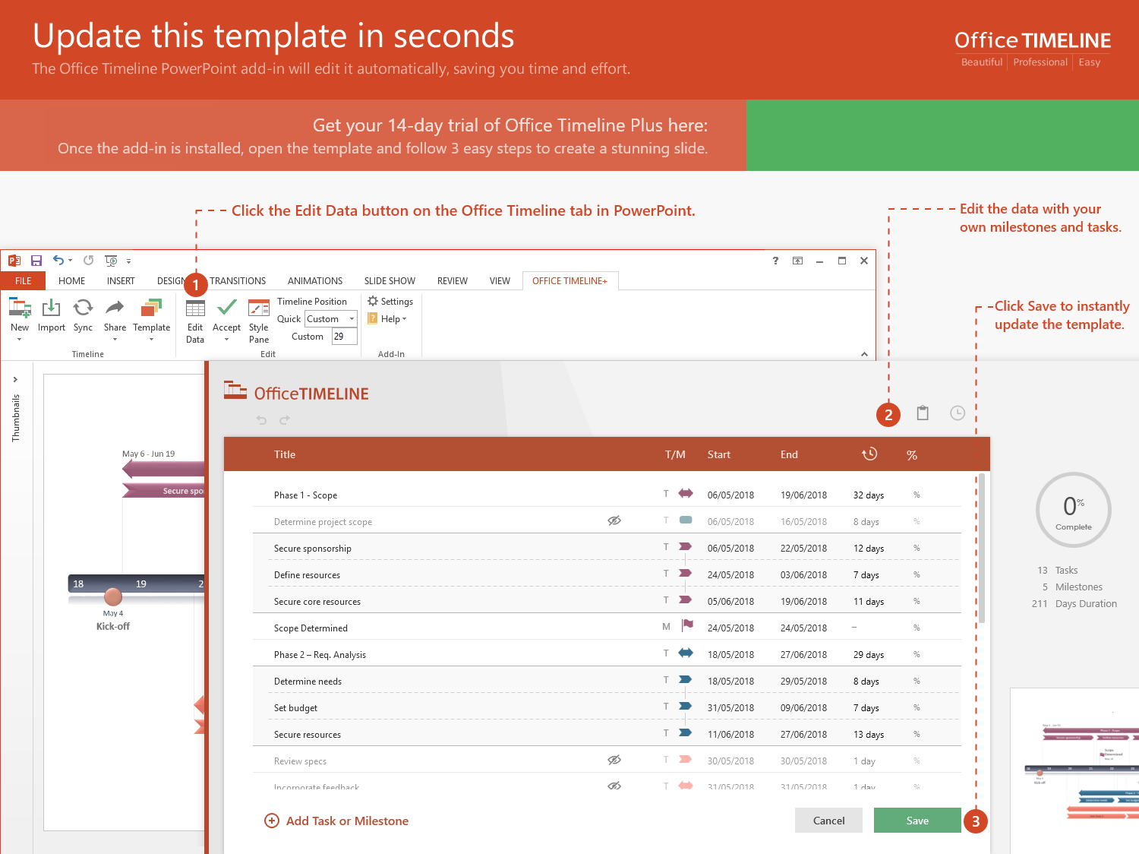
https://www.officetimeline.com/14-days-trial

Slide 2
Marketing Plan Timeline
Phase 1 Here
18 days
Jul 20 - Aug 14
Phase 2 Here
18 days
Aug 15 - Sep 7
Phase 3 Here
24 days
Aug 15 - Sep 17
Phase 4 Here
16 days
Sep 8 - Sep 30
Phase 5 Here
25 days
Oct 4 - Nov 7
Phase 6 Here
21 days
Nov 11 - Dec 11
Milestone 2
Milestone 5
Milestone 1
Jun 7
Milestone 3
Milestone 4
Oct 30
Milestone 6
May 10
Aug 12
Sep 25
Nov 15
2017
May
Jun
Jul
Aug
Sep
Oct
Nov
Dec
2017
Today
Dec 18
Milestone 7

